Slide 1
vRouter DPDK performance
tests
DRAFT
Damian Szeluga, Przemysław Grygiel

Slide 2
Lab description

Slide 3
Hardware configuration (Intel)
# lscpu
Architecture: x86_64
CPU op-mode(s): 32-bit, 64-bit
Byte Order: Little Endian
CPU(s): 56
On-line CPU(s) list: 0-55
Thread(s) per core: 2
Core(s) per socket: 14
Socket(s): 2
NUMA node(s): 2
Vendor ID: GenuineIntel
CPU family: 6
Model: 85
Model name: Intel(R) Xeon(R) Gold 5120 CPU @ 2.20GHz
Stepping: 4
CPU MHz: 2200.000
BogoMIPS: 4400.00
Virtualization: VT-x
L1d cache: 32K
L1i cache: 32K
L2 cache: 1024K
L3 cache: 19712K
NUMA node0 CPU(s): 0,2,4,6,8,10,12,14,16,18,20,22,24,26,28,30,32,34,36,38,40,42,44,46,48,50,52,54
NUMA node1 CPU(s): 1,3,5,7,9,11,13,15,17,19,21,23,25,27,29,31,33,35,37,39,41,43,45,47,49,51,53,55
# lspci | grep -i Eth
19:00.0 Ethernet controller: Intel Corporation Ethernet Controller X710 for 10GbE SFP+ (rev 02)
19:00.1 Ethernet controller: Intel Corporation Ethernet Controller X710 for 10GbE SFP+ (rev 02)
19:00.2 Ethernet controller: Intel Corporation Ethernet Controller X710 for 10GbE SFP+ (rev 02)
19:00.3 Ethernet controller: Intel Corporation Ethernet Controller X710 for 10GbE SFP+ (rev 02)

Slide 4
Hardware configuration (AMD)
# lscpu
Architecture: x86_64
CPU op-mode(s): 32-bit, 64-bit
Byte Order: Little Endian
CPU(s): 256
On-line CPU(s) list: 0-255
Thread(s) per core: 2
Core(s) per socket: 64
Socket(s): 2
NUMA node(s): 8
Vendor ID: AuthenticAMD
CPU family: 23
Model: 49
Model name: AMD EPYC 7742 64-Core Processor
Stepping: 0
CPU MHz: 2250.000
CPU max MHz: 2250.0000
CPU min MHz: 1500.0000
BogoMIPS: 4491.54
Virtualization: AMD-V
L1d cache: 32K
L1i cache: 32K
L2 cache: 512K
L3 cache: 16384K
NUMA node0 CPU(s): 0-15,128-143
NUMA node1 CPU(s): 16-31,144-159
NUMA node2 CPU(s): 32-47,160-175
NUMA node3 CPU(s): 48-63,176-191
NUMA node4 CPU(s): 64-79,192-207
NUMA node5 CPU(s): 80-95,208-223
NUMA node6 CPU(s): 96-111,224-239
NUMA node7 CPU(s): 112-127,240-255
#lspci | grep -i Eth
01:00.0 Ethernet controller: Intel Corporation Ethernet Controller X710 for 10GbE SFP+ (rev 01)
01:00.1 Ethernet controller: Intel Corporation Ethernet Controller X710 for 10GbE SFP+ (rev 01)
01:00.2 Ethernet controller: Intel Corporation Ethernet Controller X710 for 10GbE SFP+ (rev 01)
01:00.3 Ethernet controller: Intel Corporation Ethernet Controller X710 for 10GbE SFP+ (rev 01)
21:00.0 Ethernet controller: Mellanox Technologies MT27710 Family [ConnectX-4 Lx]
21:00.1 Ethernet controller: Mellanox Technologies MT27710 Family [ConnectX-4 Lx]

Slide 5
System configuration (Intel)
# grep ^CPU_LIST /etc/sysconfig/network-scripts/ifcfg-vhost0
CPU_LIST=2,4,6,30,32,34
# cat /proc/cmdline
BOOT_IMAGE=/boot/vmlinuz-3.10.0-1062.1.2.el7.x86_64 root=UUID=07ccf9fd-6946-4d2a-89ba-ff3c7668bd83 ro console=tty0 console=ttyS0,115200n8 crashkernel=auto rhgb quiet iommu=pt isolcpus=2-27,30-55 intel_iommu=on default_hugepagesz=1GB hugepagesz=1G hugepages=128 hugepagesz=2M hugepages=8192 skew_tick=1 nohz=on nohz_full=2-27,30-55 rcu_nocbs=2-27,30-55 tuned.non_isolcpus=30000003 intel_pstate=disable nosoftlockup
# grep ^isolated_cores /etc/tuned/cpu-partitioning-variables.conf
isolated_cores=2-27,30-55
# grep ^vcpu /var/lib/config-data/puppet-generated/nova_libvirt/etc/nova/nova.conf
vcpu_pin_set=12,14,16,18,20,22,24,26,34,36,38,40,42,44,46,48,50,52
# docker ps --filter name=contrail --format "{{.Image}}\t{{.Names}}"
192.168.213.1:8787/contrail-vrouter-agent-dpdk:1910.23-rhel-queens contrail-vrouter-agent-dpdk
192.168.213.1:8787/contrail-vrouter-agent:1910.23-rhel-queens contrail_vrouter_agent
192.168.213.1:8787/contrail-nodemgr:1910.23-rhel-queens contrail_vrouter_agent_nodemgr
# sed -e "s/\x00/ /g" /proc/$(pidof contrail-vrouter-dpdk)/cmdline
/usr/bin/contrail-vrouter-dpdk --no-daemon --vr_flow_entries=2000000 --vr_mempool_sz 131072 --dpdk_txd_sz 2048 --dpdk_rxd_sz 2048 --socket-mem 1024 1024 --vdev eth_bond_bond1,mode=4,xmit_policy=l34,socket_id=0,mac=e4:43:4b:6e:95:40,lacp_rate=0,slave=0000:19:00.0,slave=0000:19:00.1

Slide 6
System configuration (AMD)
# grep ^CPU_LIST /etc/sysconfig/network-scripts/ifcfg-vhost0
CPU_LIST=32,33,160,161
# cat /proc/cmdline
BOOT_IMAGE=/boot/vmlinuz-3.10.0-1062.1.2.el7.x86_64 root=UUID=07ccf9fd-6946-4d2a-89ba-ff3c7668bd83 ro console=tty0 console=ttyS0,115200n8 crashkernel=auto rhgb quiet amd_iommu=on iommu=pt isolcpus=2-63,67-127,130-191,195-255 iommu=pt intel_iommu=on default_hugepagesz=1GB hugepagesz=1G hugepages=196 hugepagesz=2M hugepages=8192 skew_tick=1 nohz=on nohz_full=2-63,67-127,130-191,195-255 rcu_nocbs=2-63,67-127,130-191,195-255 tuned.non_isolcpus=00000007,00000000,00000003,00000000,00000007,00000000,00000003 intel_pstate=disable nosoftlockup
# grep ^isolated_cores /etc/tuned/cpu-partitioning-variables.conf
isolated_cores=2-63,67-127,130-191,195-255
# grep ^vcpu_pin_set /var/lib/config-data/puppet-generated/nova_libvirt/etc/nova/nova.conf
vcpu_pin_set=18-31,146-159
# docker ps --filter name=contrail --format "{{.Image}}\t{{.Names}}"
192.168.213.1:8787/contrail-vrouter-agent-dpdk:1910.23-rhel-queens contrail-vrouter-agent-dpdk
192.168.213.1:8787/contrail-vrouter-agent:1910.23-rhel-queens contrail_vrouter_agent
192.168.213.1:8787/contrail-nodemgr:1910.23-rhel-queens contrail_vrouter_agent_nodemgr
# sed -e "s/\x00/ /g" /proc/$(pidof contrail-vrouter-dpdk)/cmdline
/usr/bin/contrail-vrouter-dpdk --no-daemon --vr_flow_entries=2000000 --vr_mempool_sz 131072 --dpdk_txd_sz 2048 --dpdk_rxd_sz 2048 --socket-mem 1024 1024 --vdev eth_bond_bond1,mode=4,xmit_policy=l34,socket_id=0,mac=98:03:9b:a7:3b:a0,lacp_rate=0,slave=0000:21:00.0,slave=0000:21:00.1

Slide 7
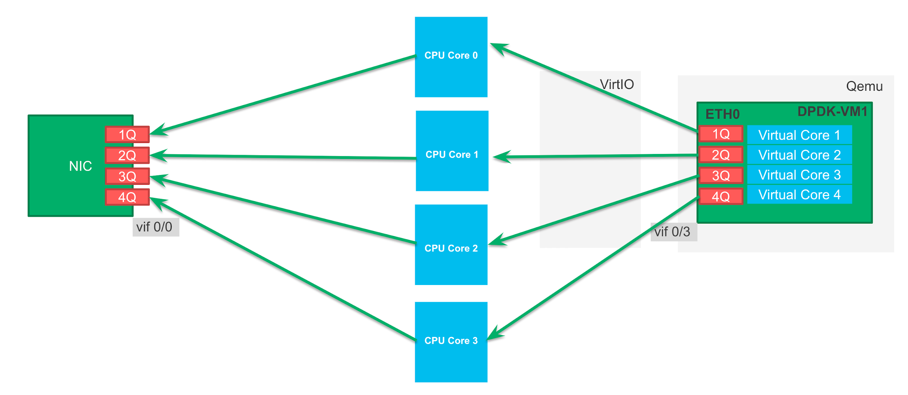
vRouter prototype - changes description
A - Disabled yield
If there is no traffic, lcore is not going into power save mode
B - Disabled hash on NIC side
After polling packets from NICs, RSS hash is not calculated
C- Disabled intercore communication on a VM side.
A polling core is a processing core, RSS hash need to be done on a VM side to equally balance traffic across cores

Slide 8
Links to prototype code diffs
A - Disabled yield
diff --git a/include/vr_dpdk.h b/include/vr_dpdk.h
index 6f5f12d..ff744ef 100644
--- a/include/vr_dpdk.h
+++ b/include/vr_dpdk.h
@@ -199,7 +199,7 @@ extern unsigned vr_packet_sz;
#define VR_DPDK_SLEEP_NO_QUEUES_US 10000
/* Sleep (in US) or yield if no packets received (use 0 to disable) */
#define VR_DPDK_SLEEP_NO_PACKETS_US 0
-#define VR_DPDK_YIELD_NO_PACKETS 1
+#define VR_DPDK_YIELD_NO_PACKETS 0
/* Sleep (in US) no packets received on any TAP devs (use 0 to disable) */
#define VR_DPDK_TAPDEV_SLEEP_NO_PACKETS_US 500
/* Timers handling periodicity in US */

Slide 9
Links to prototype code diffs
B - Disabled hash on NIC side
diff --git a/dpdk/vr_dpdk_lcore.c b/dpdk/vr_dpdk_lcore.c
index 0d1d424..a3de065 100644
--- a/dpdk/vr_dpdk_lcore.c
+++ b/dpdk/vr_dpdk_lcore.c
@@ -931,9 +931,7 @@ dpdk_lcore_rxqs_vroute(struct vr_dpdk_lcore *lcore)
* redistribute only those altered packets to other lcores.
*/
if (vif_is_fabric(rx_queue->q_vif)) {
- /* (Re)calculate hashes and strip VLAN tags. */
- mask_to_distribute = vr_dpdk_ethdev_rx_emulate(rx_queue->q_vif,
- pkts, &nb_pkts);
+ mask_to_distribute = 0;
if (likely(mask_to_distribute == 0)) {
/* Packets have been hashed by NIC, just route them. */
vr_dpdk_lcore_vroute(lcore, rx_queue->q_vif, pkts, nb_pkts);

Slide 10
Links to prototype code diffs
C- Disabled intercore communication on a VM side
diff --git a/dpdk/vr_dpdk_lcore.c b/dpdk/vr_dpdk_lcore.c
index 0d1d424..68943ef 100644
--- a/dpdk/vr_dpdk_lcore.c
+++ b/dpdk/vr_dpdk_lcore.c
@@ -958,17 +956,7 @@ dpdk_lcore_rxqs_vroute(struct vr_dpdk_lcore *lcore)
nb_pkts_to_route);
}
} else {
- /* For non-fabric interfaces we always distribute the packets. */
- mask_to_distribute = vr_dpdk_ethdev_rx_emulate(rx_queue->q_vif,
- pkts, &nb_pkts);
- if (likely(mask_to_distribute != 0)) {
- /* Distribute all the packets. */
- vr_dpdk_lcore_distribute(lcore, false, rx_queue->q_vif,
- pkts, nb_pkts);
- } else {
- /* No other lcores to distribute, so just route the packets. */
- vr_dpdk_lcore_vroute(lcore, rx_queue->q_vif, pkts, nb_pkts);
- }
+ vr_dpdk_lcore_vroute(lcore, rx_queue->q_vif, pkts, nb_pkts);
}
}
}

Slide 11
Testing a tool description

Slide 12
Rapid introduction
Rapid is a wrapper on Prox to run tests and collect results.
Rapid wiki https://wiki.opnfv.org/display/SAM/Rapid+scripting
All tests are being driven by https://svl-ssd-git.juniper.net/sre/dpdk-testing

Slide 13
VM to VM traffic (compute to compute)
Bare metal
Compute A
Compute B
LACP Bond
20Gbps
LACP Bond
20Gbps
Prox
generate
VM
Prox
looping
VM
eth0
Switching fabric
Spine and leaf
eth0
NIC1
NIC1
vRouter
vRouter
eth1
NIC2
NIC2
eth1
Rapid jump VM
Control traffic only
eth1
Test traffic
Control traffic
Compute C

Slide 14
Note
GA means:
Contrail Networking R1910 code
rebuilt with:
MLXS support
CONFIG_RTE_MAX_LCORE changed to 256 (from 128)
vRouter Prototype means:
GA (from description above)
patches A, B and C (mentioned earlier).
All tests have been performed on environment deployed with Contrail Cloud 13.2.0.
For 1024b and 1500b packet size, 20Gbit throughput caps results.
All tests were performed with pinning service cores to dedicated core (unless otherwise stated).

Slide 15
vRouter GA
vs
vRouter Prototype
vs
OVS

Slide 16
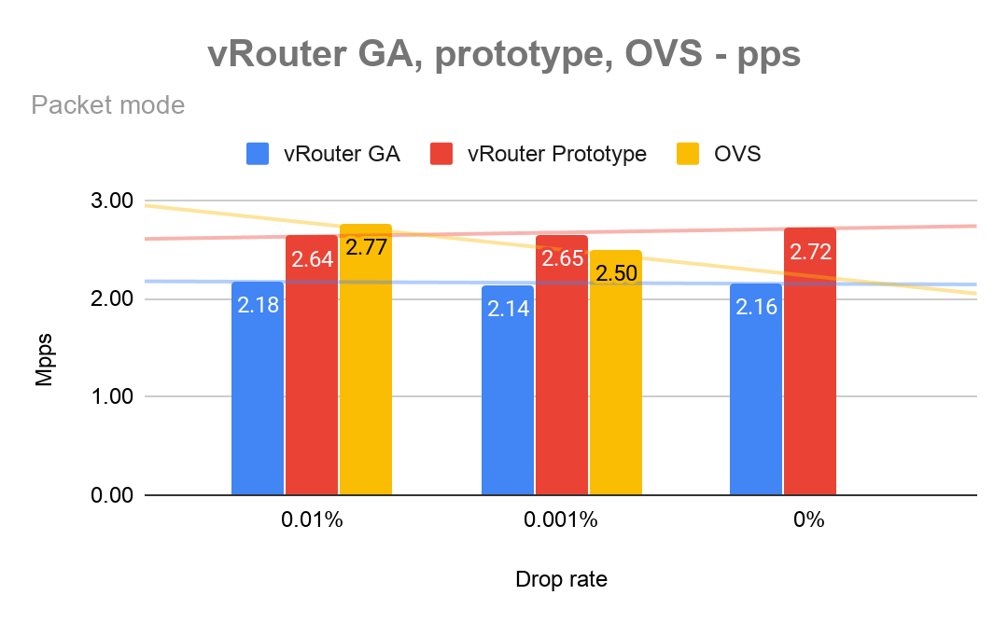
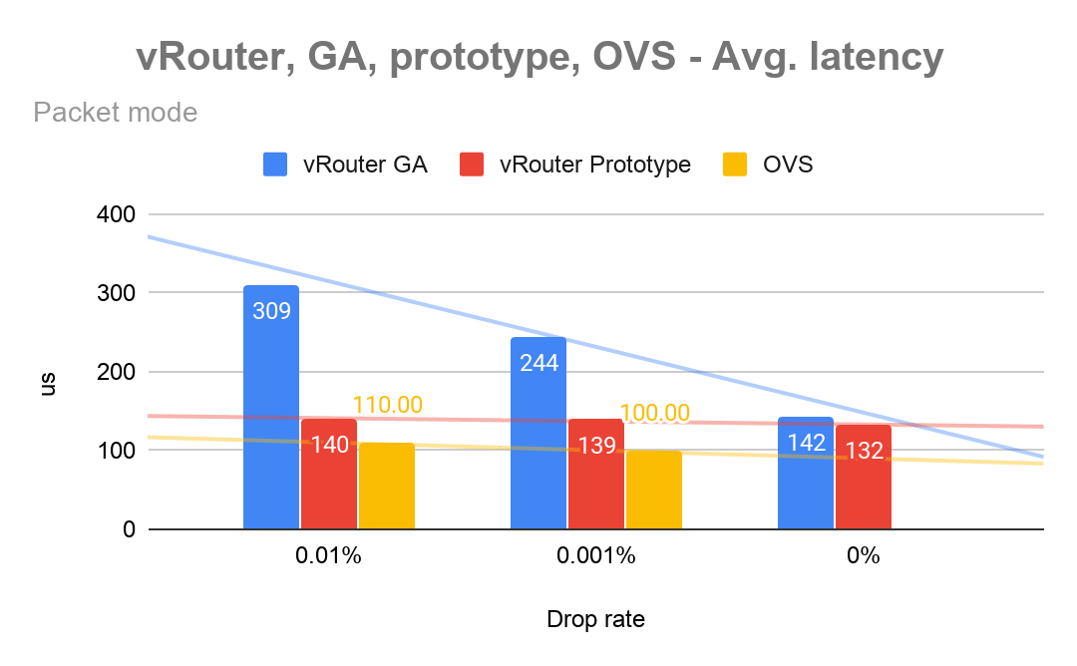
vRouter GA, prototype, OVS
Source

Slide 17
vRouter packet mode
vs
flow mode

Slide 18
VM to VM traffic (compute to compute)
Bare metal
Compute A
Compute B
LACP Bond
20Gbps
LACP Bond
20Gbps
Prox
generate
VM
Prox
looping
VM
eth0
Switching fabric
Spine and leaf
eth0
NIC1
NIC1
vRouter
vRouter
eth1
NIC2
NIC2
eth1
Rapid jump VM
Control traffic only
eth1
Test traffic
Control traffic
Compute C

Slide 19
vRouter packet vs flow mode - packets per second
Source

Slide 20
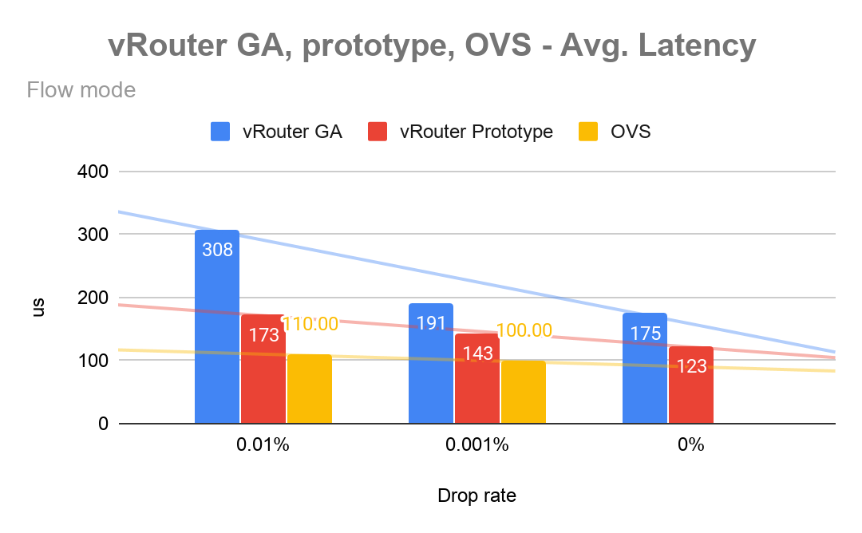
vRouter packet vs flow mode - latency
Source

Slide 21
vRouter flows

Slide 22
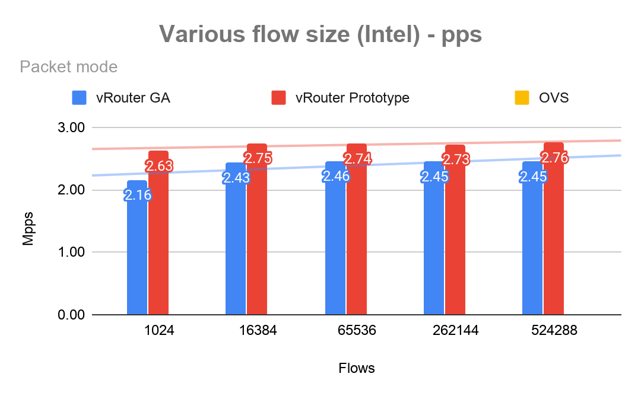
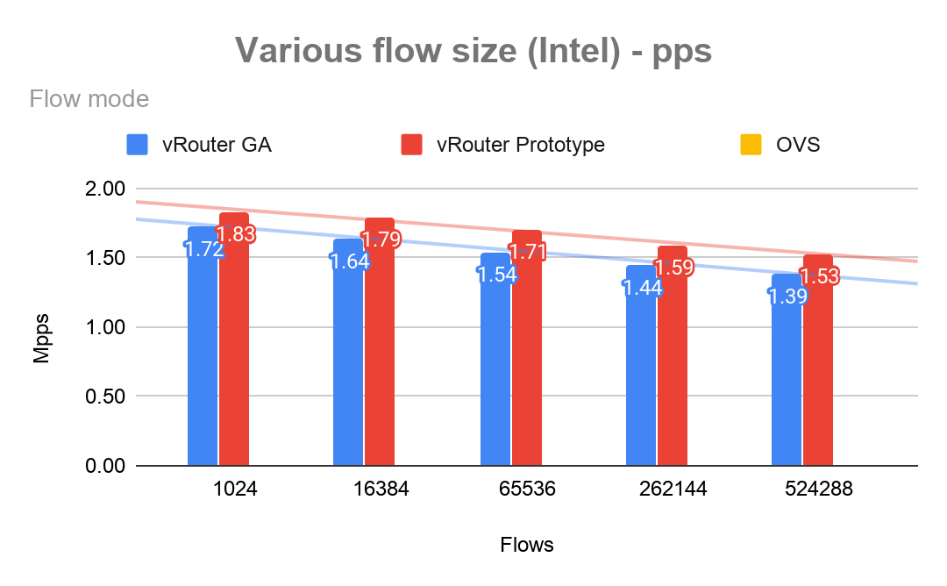
Various flows size - pps
Source

Slide 23
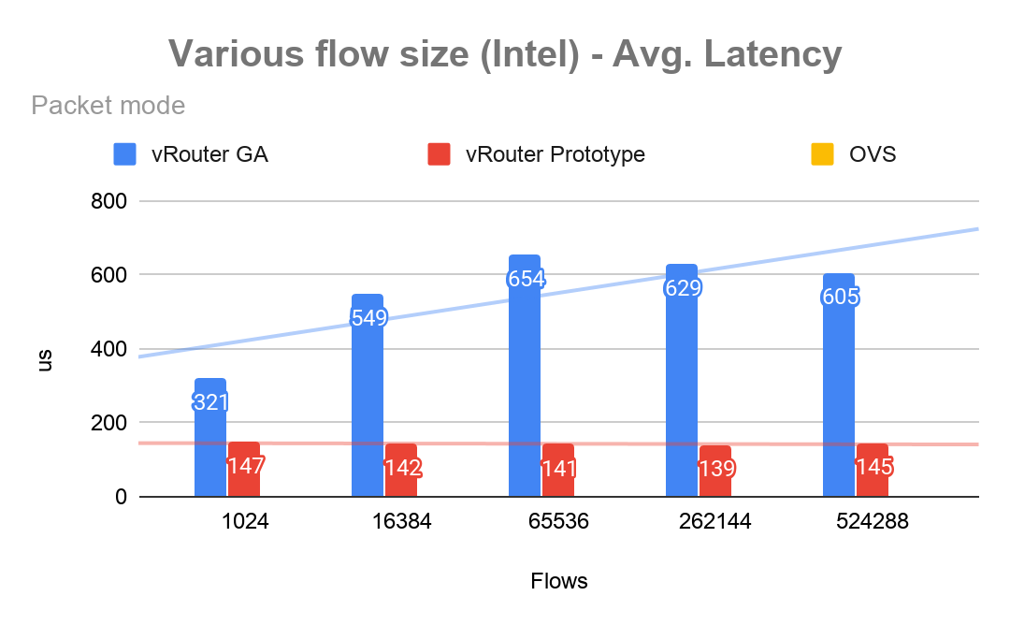
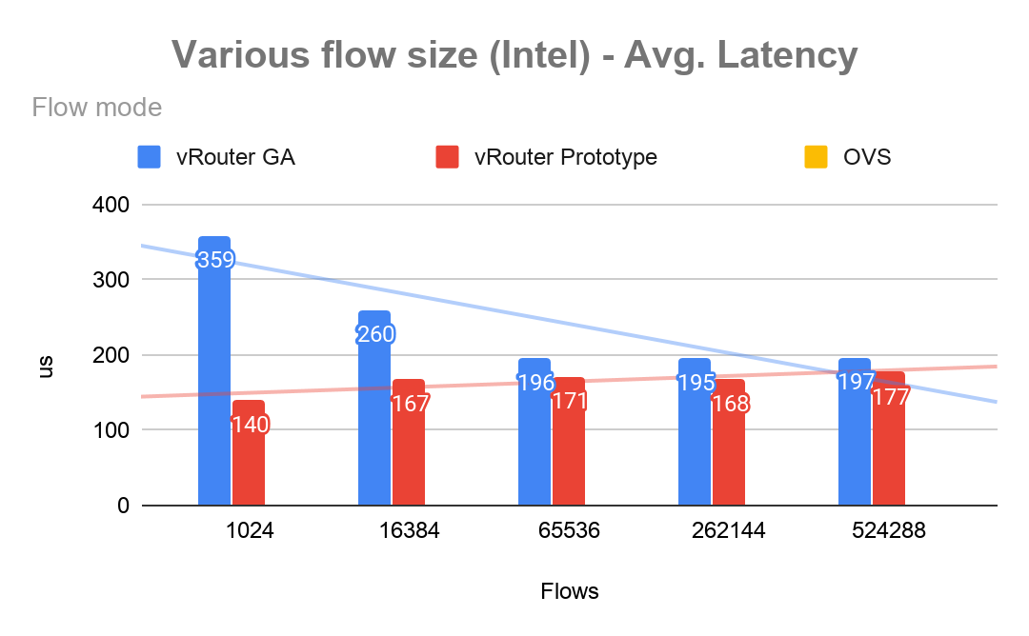
Various flows size - latency
Source

Slide 24
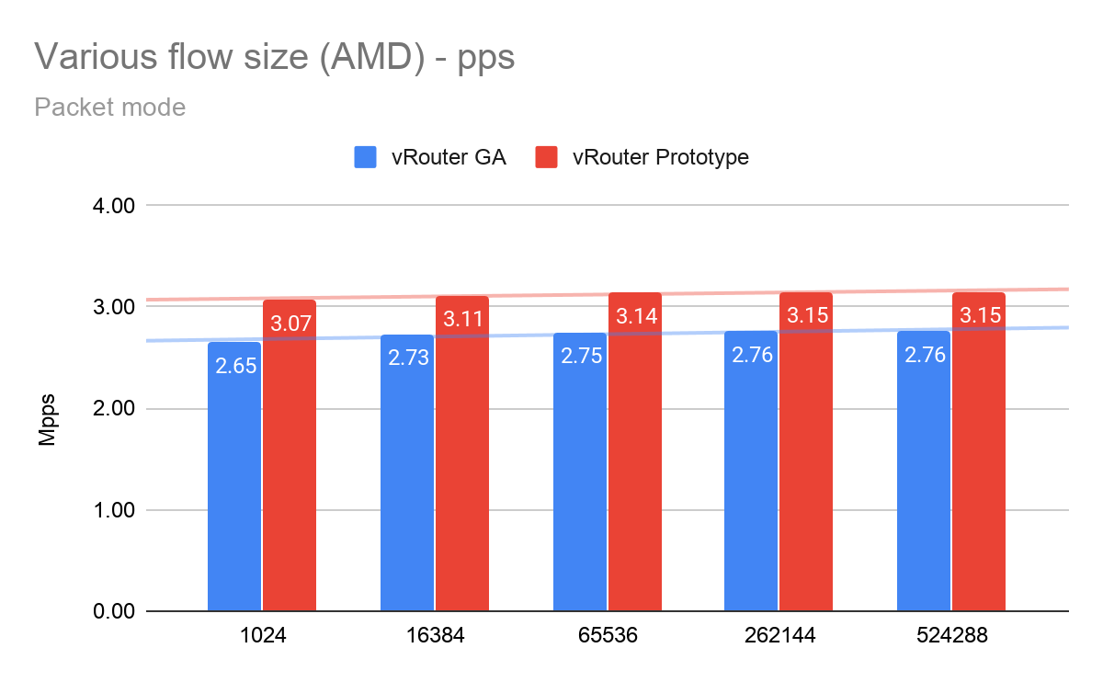
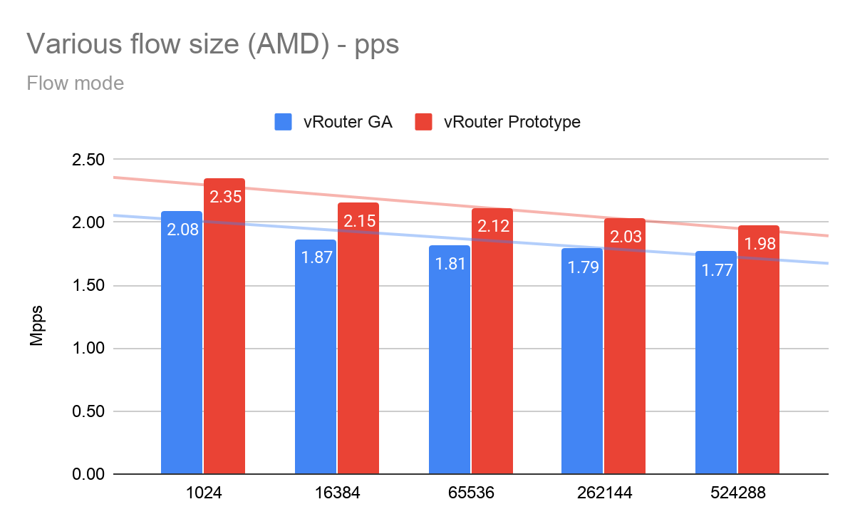
Various flows size (AMD) - pps
Source

Slide 25
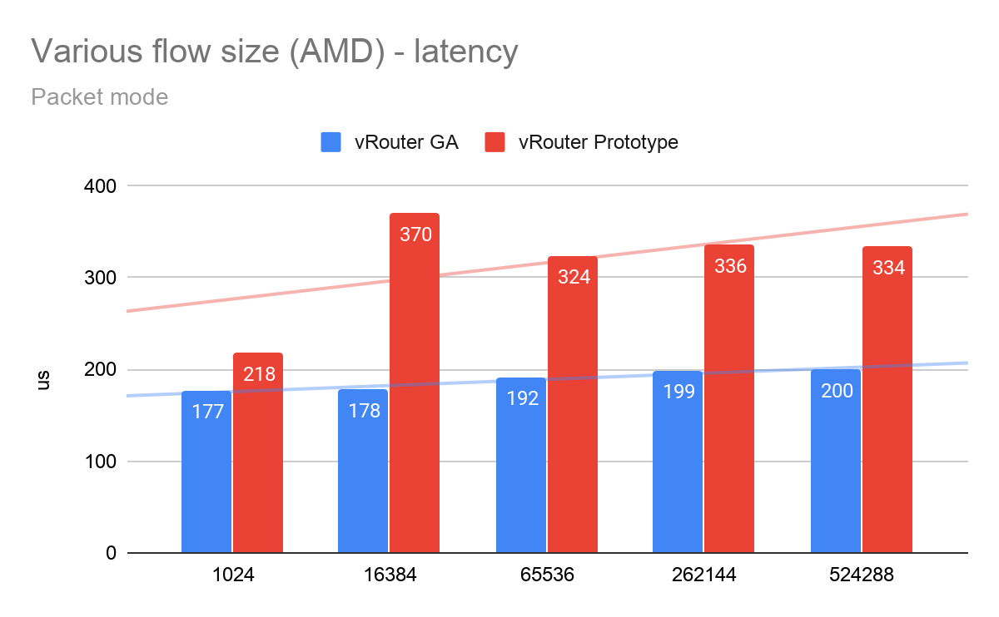

Various flows size (AMD) - latency
Source

Slide 26
NUMA placement

Slide 27
Intel - vRouter, NICs and VM on NUMA 0 (same NUMA)
Bare metal
Compute A
Compute B
LACP Bond
20Gbps
LACP Bond
20Gbps
NUMA 0
Prox
generate
VM
Prox
looping
VM
eth0
Switching fabric
Spine and leaf
eth0
NIC1
NIC1
vRouter
vRouter
eth1
NIC2
NIC2
eth1
Rapid jump VM
Control traffic only
eth1
Test traffic
Control traffic
Compute C

Slide 28
Intel - vRouter, NICs on NUMA 0, VM on NUMA 1 (Different NUMA)
Bare metal
Compute A
Compute B
LACP Bond
20Gbps
NUMA 0
NUMA 1
LACP Bond
20Gbps
Prox
generate
VM
Prox
looping
VM
eth0
Switching fabric
Spine and leaf
eth0
NIC1
NIC1
vRouter
vRouter
eth1
NIC2
NIC2
eth1
Rapid jump VM
Control traffic only
eth1
Test traffic
Control traffic
Compute C

Slide 29
AMD - vRouter, NICs on NUMA 0, VM on NUMA 1 (Different NUMA)
Bare metal
Compute A
Compute B
LACP Bond
20Gbps
NUMA 0
NUMA 1
LACP Bond
20Gbps
Prox
generate
VM
Prox
looping
VM
eth0
Switching fabric
Spine and leaf
eth0
NIC1
NIC1
vRouter
vRouter
eth1
NIC2
NIC2
eth1
Rapid jump VM
Control traffic only
eth1
Test traffic
Control traffic
Compute C

Slide 30
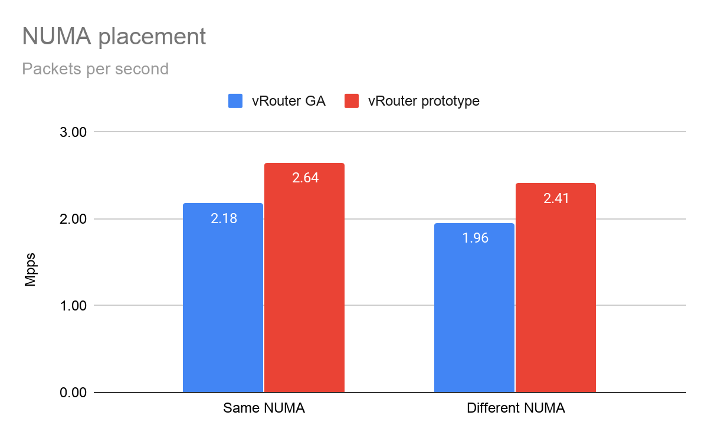
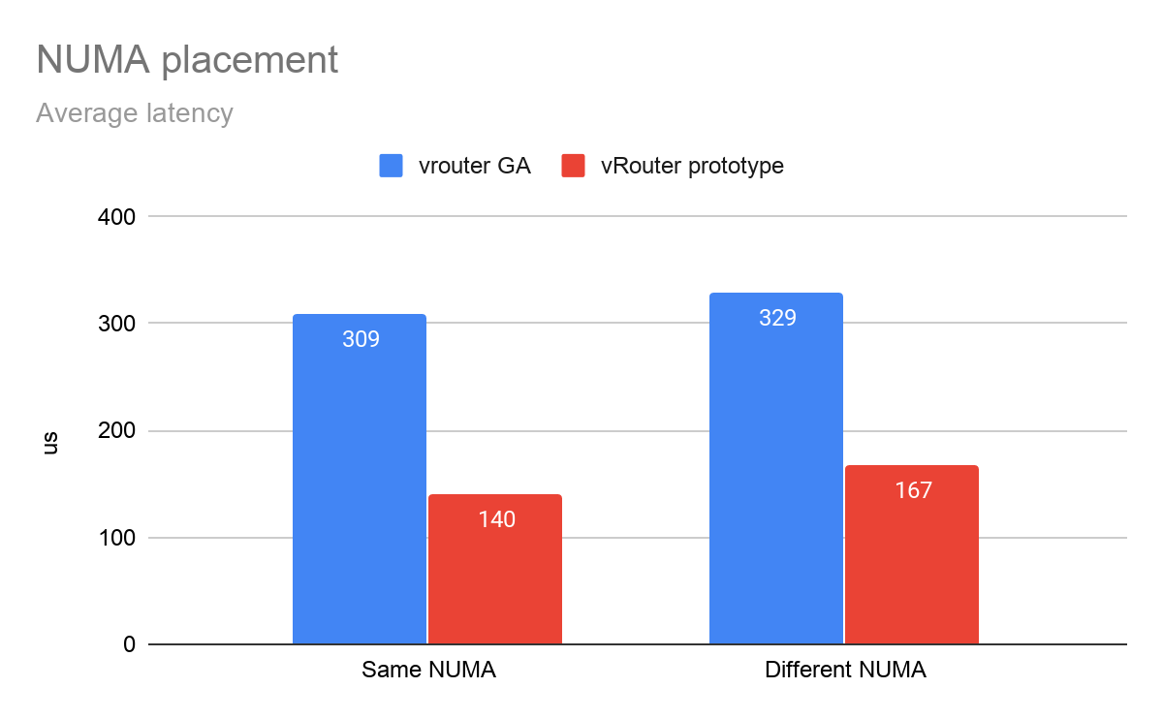
NUMA topology placement (Intel)
Source

Slide 31
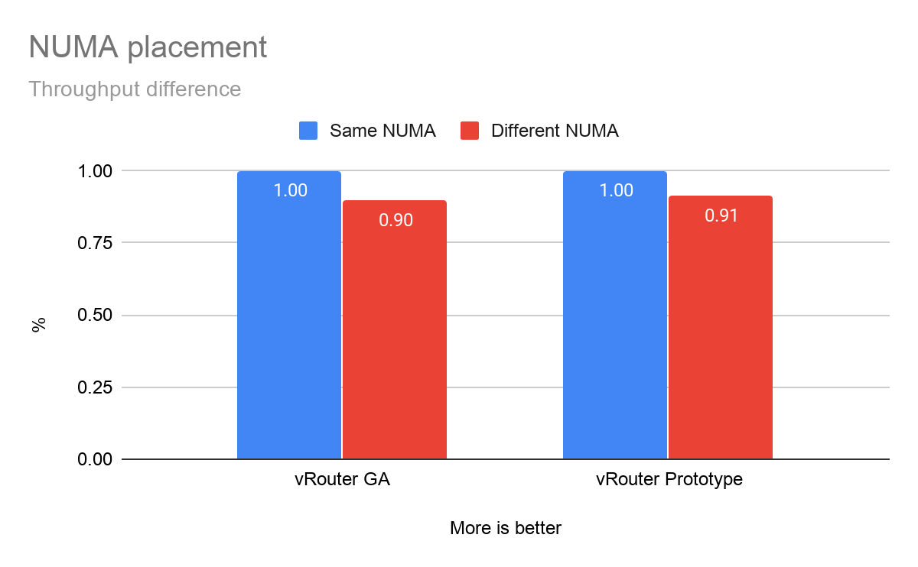
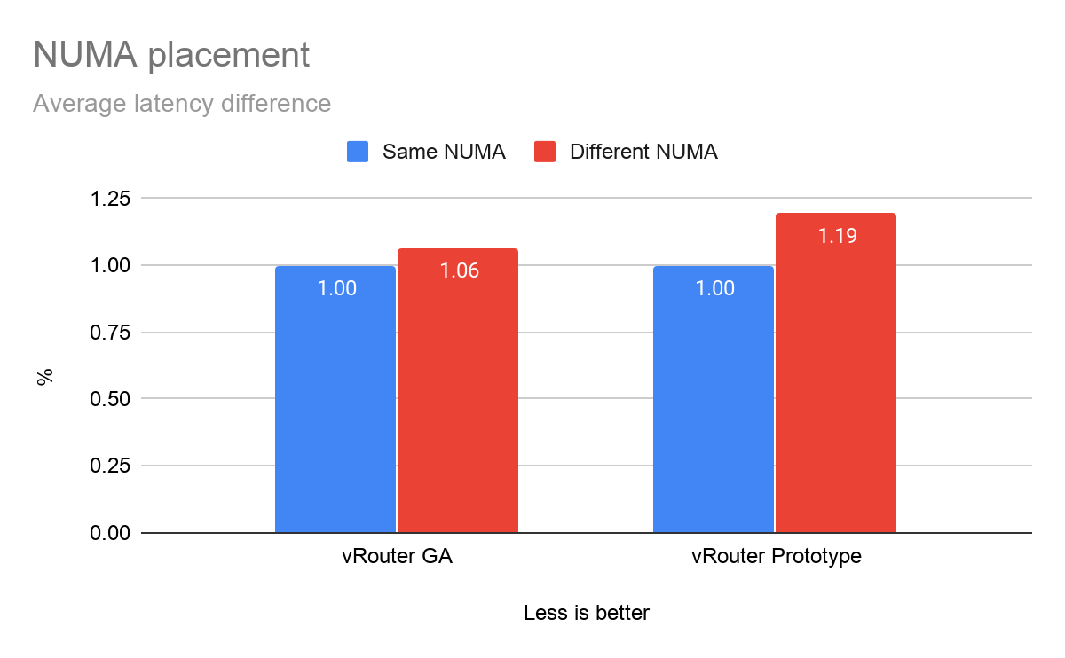
NUMA topology placement (Intel) - differences
Source

Slide 32
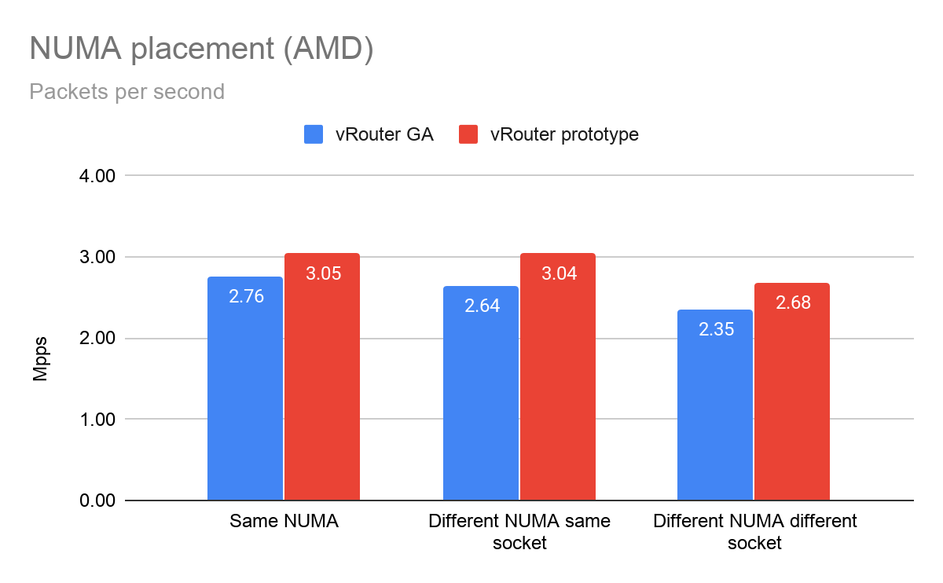
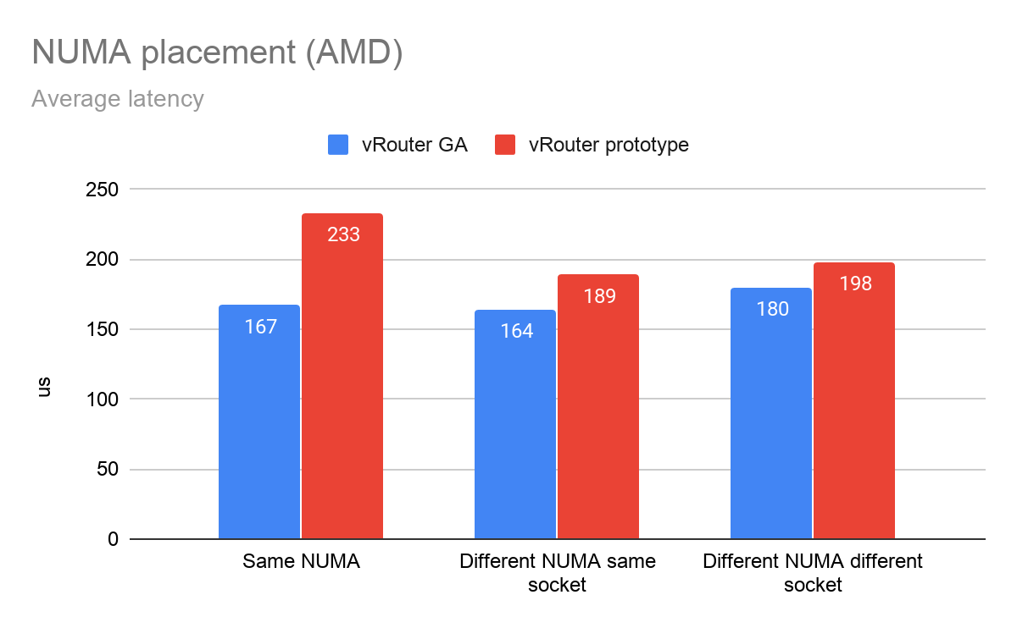
NUMA topology placement (AMD)
Source

Slide 33
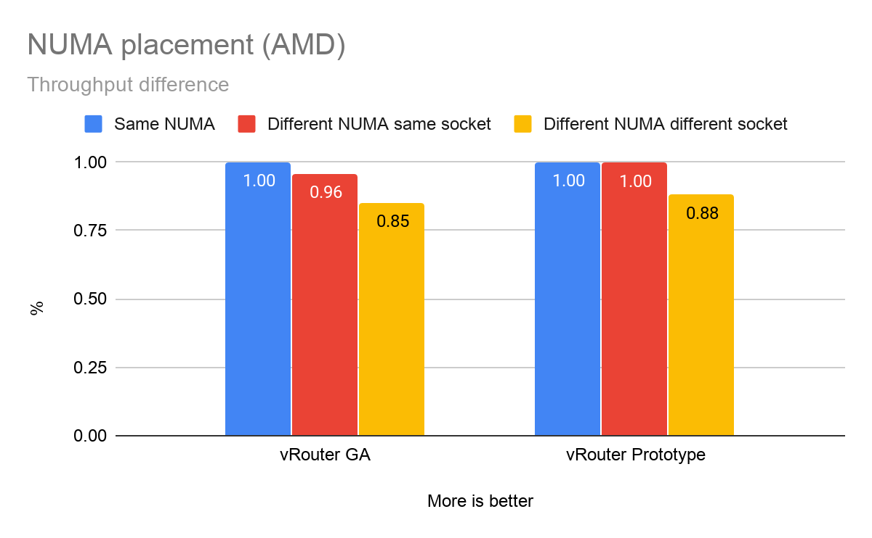
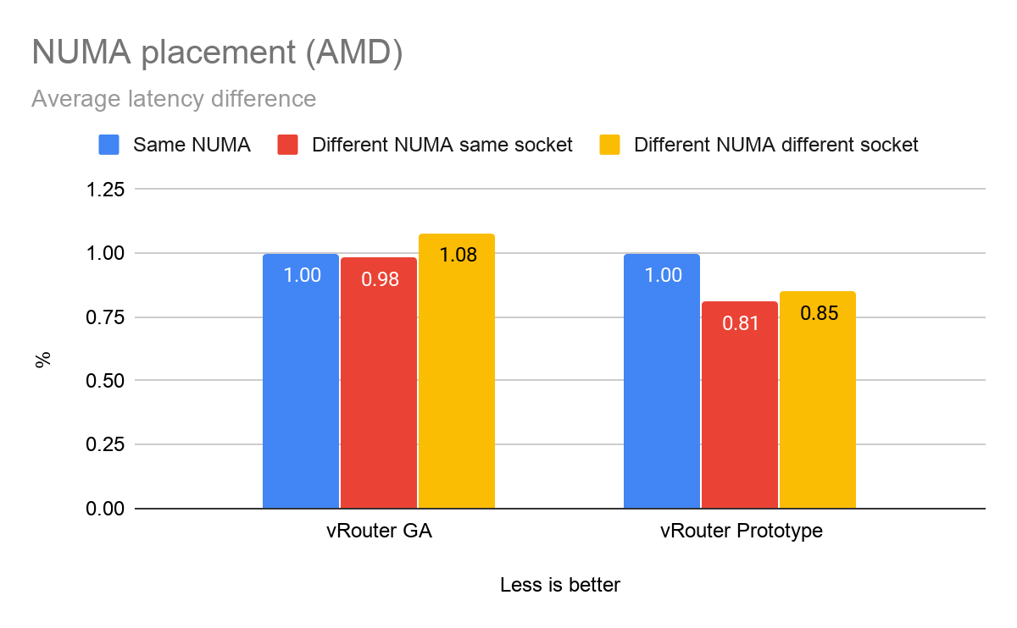
NUMA topology placement (AMD) - differences
Source

Slide 34
1 vs 2 vs 3 physical cores

Slide 35
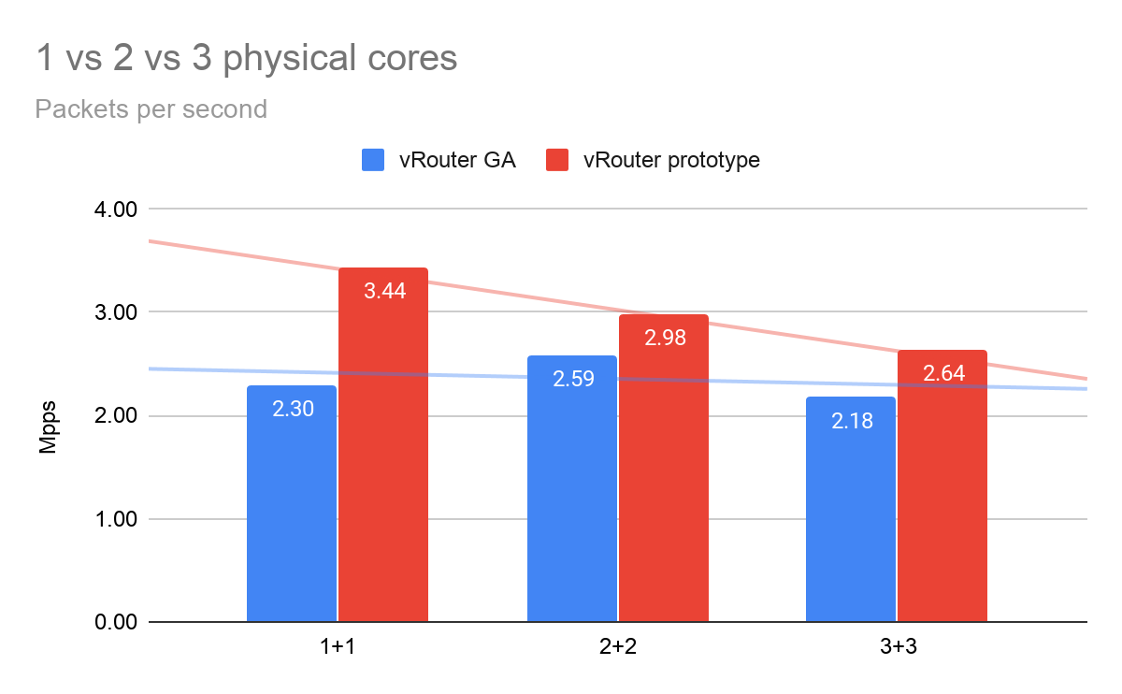
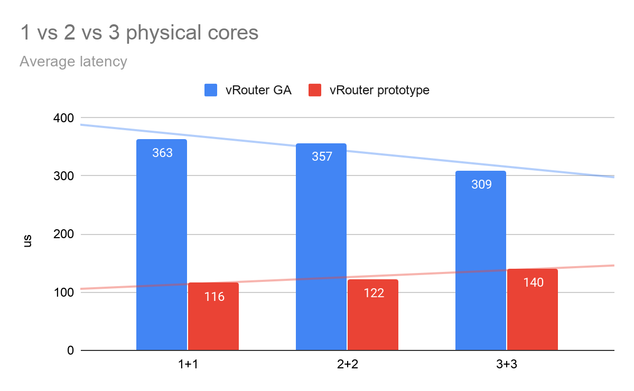
1 vs 2 vs 3 physical cores (+ siblings)
Source

Slide 36
HT siblings
vs
without HT siblings

Slide 37
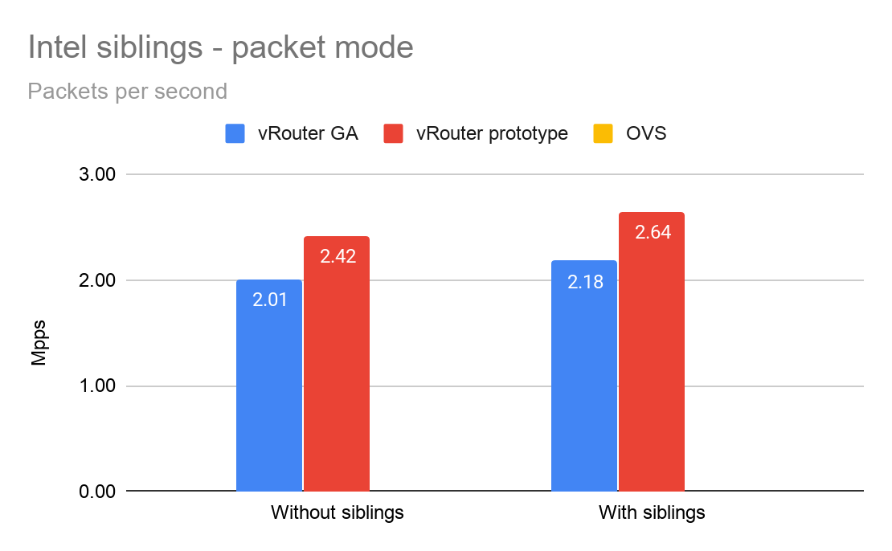
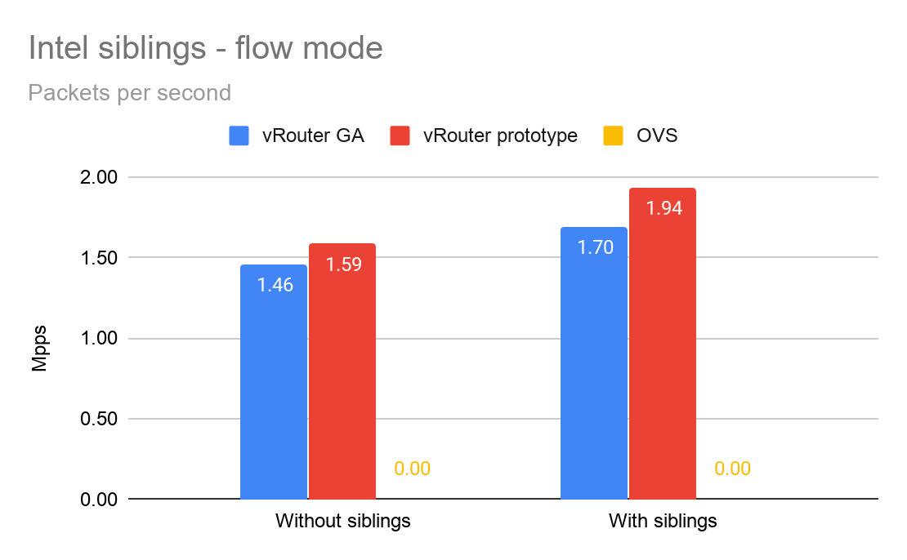
HT siblings vs no HT siblings (Intel)
Source

Slide 38
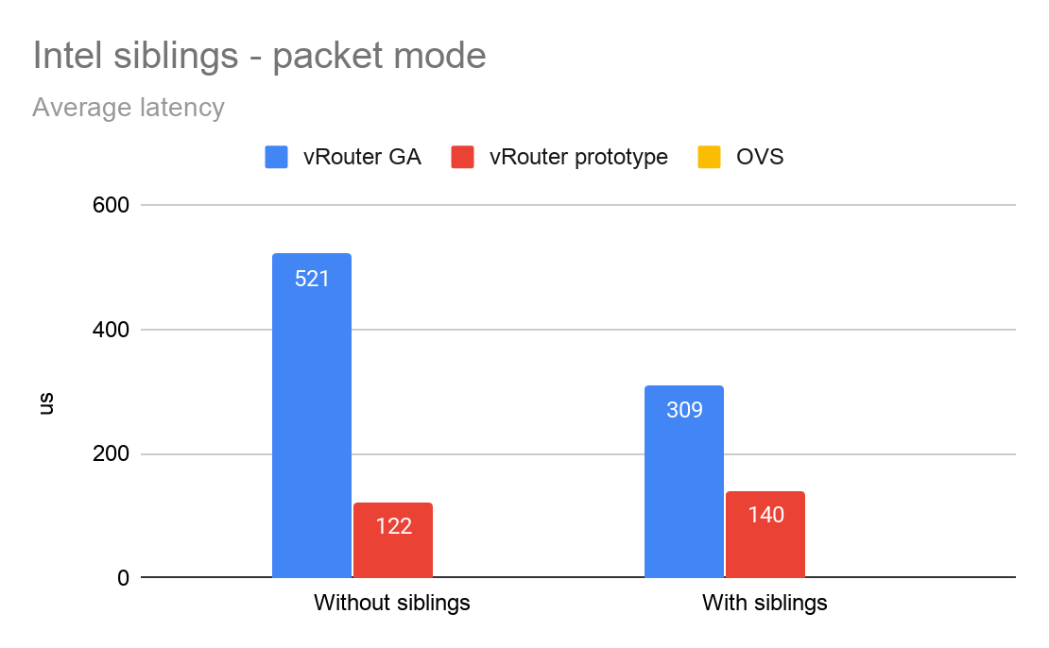
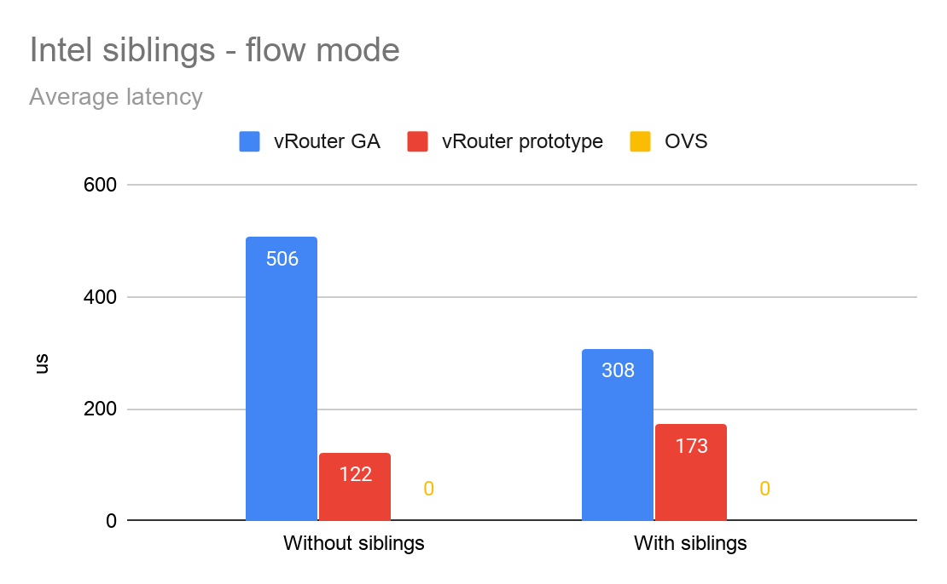
HT siblings vs no HT siblings (Intel)
Source

Slide 39
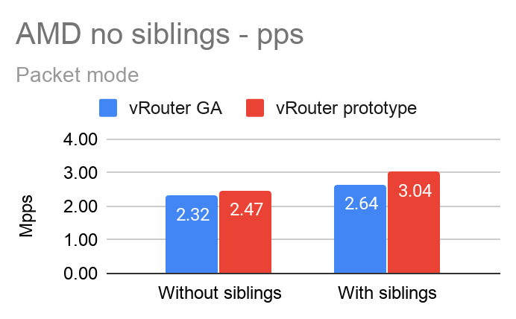
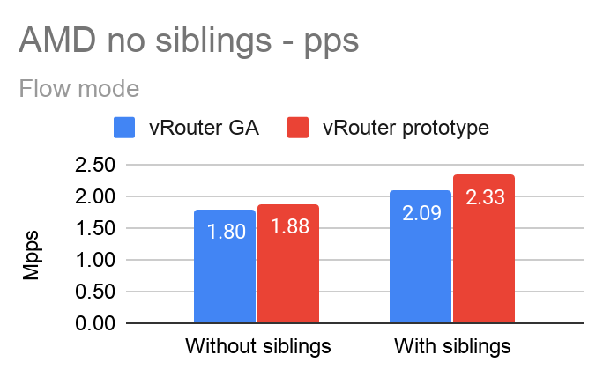
HT siblings vs no HT siblings (AMD)
Source

Slide 40
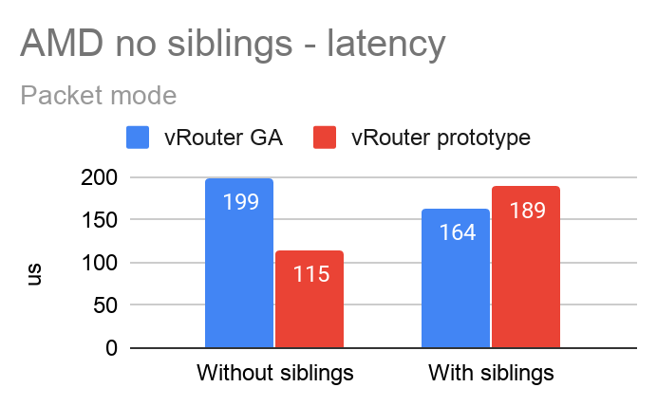
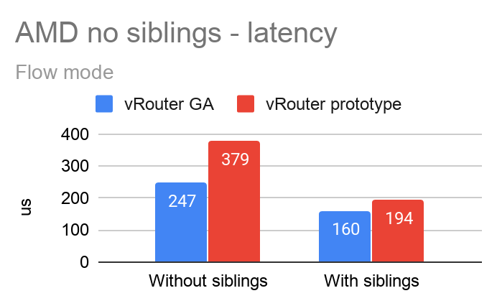
HT siblings vs no HT siblings (AMD)
Source

Slide 41
VM to VM traffic (compute to compute)
Bare metal
Compute A
Compute B
LACP Bond
20Gbps
LACP Bond
20Gbps
Prox
generate
VM
Prox
looping
VM
eth0
Switching fabric
Spine and leaf
eth0
NIC1
NIC1
vRouter
vRouter
eth1
NIC2
NIC2
eth1
Rapid jump VM
Control traffic only
eth1
Test traffic
Control traffic
Compute C

Slide 42
Encapsulation MPLSoUDP
vs
MPLSoGRE
vs VxLAN

Slide 43
VM to VM traffic (compute to compute)
Bare metal
Compute A
Compute B
LACP Bond
20Gbps
LACP Bond
20Gbps
Prox
generate
VM
Prox
looping
VM
eth0
Switching fabric
Spine and leaf
eth0
NIC1
NIC1
vRouter
vRouter
eth1
NIC2
NIC2
eth1
Rapid jump VM
Control traffic only
eth1
Test traffic
Control traffic
Compute C

Slide 44
Intel x710 vs Intel x520 vs
Mellanox xConnect 4

Slide 45
VM to VM traffic (compute to compute)
Bare metal
Compute A
Compute B
LACP Bond
20Gbps
LACP Bond
20Gbps
Prox
generate
VM
Prox
looping
VM
eth0
Switching fabric
Spine and leaf
eth0
NIC1
NIC1
vRouter
vRouter
eth1
NIC2
NIC2
eth1
Rapid jump VM
Control traffic only
eth1
Test traffic
Control traffic
Compute C

Slide 46
Intel vs AMD

Slide 47
Test Intel - VM to VM traffic (compute to compute)
3pcores + 3 siblings
Measure performance here!
3pcores + 3 HT siblings
Bare metal
Compute A (Intel)
Compute B
(AMD)
LACP Bond
20Gbps
LACP Bond
20Gbps
Prox
looping
VM
Prox
swap
VM
eth0
Switching fabric
Spine and leaf
eth0
NIC1
NIC1
vRouter
vRouter
eth1
NIC2
NIC2
eth1
Rapid jump VM
Control traffic only
eth1
Test traffic
Control traffic
Compute C

Slide 48
Test AMD - VM to VM traffic (compute to compute)
Measure performance here!
3pcores + 3 siblings
3pcores + 3 HT siblings
Bare metal
Compute A (Intel)
Compute B
(AMD)
LACP Bond
20Gbps
LACP Bond
20Gbps
Prox
generate
VM
Prox
looping
VM
eth0
Switching fabric
Spine and leaf
eth0
NIC1
NIC1
vRouter
vRouter
eth1
NIC2
NIC2
eth1
Rapid jump VM
Control traffic only
eth1
Test traffic
Control traffic
Compute C

Slide 49
Use OS cores for service lcores
vs
dedicated cores for service lcores

Slide 50
Appendix

Slide 51
Appendix
Raw data can be found here: Google sheets

Slide 52
Slides backup
(no meaningful content after this slide)

Slide 53
VM to VM on the same host
vs
on different hosts

Slide 54
VM to VM traffic
LACP Bond
20Gbps
Compute A
NIC1
NIC2
Prox
generate
VM
Prox
looping
VM
eth0
eth0
vRouter
eth1
eth1
Rapid jump VM
Control traffic only
eth1
Test traffic
Control traffic
Compute C

